Slide 1
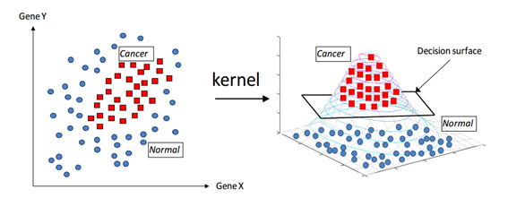
Kernel
input space
feature space

Slide 2
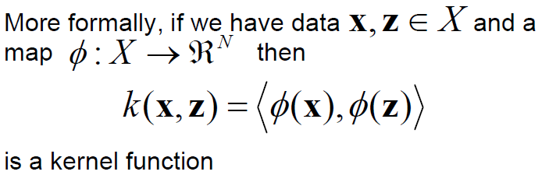
Kernel Functions -definition

Slide 3
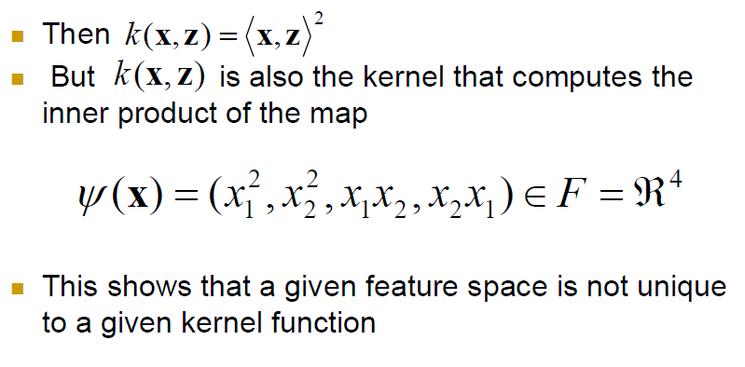
Example

Slide 4
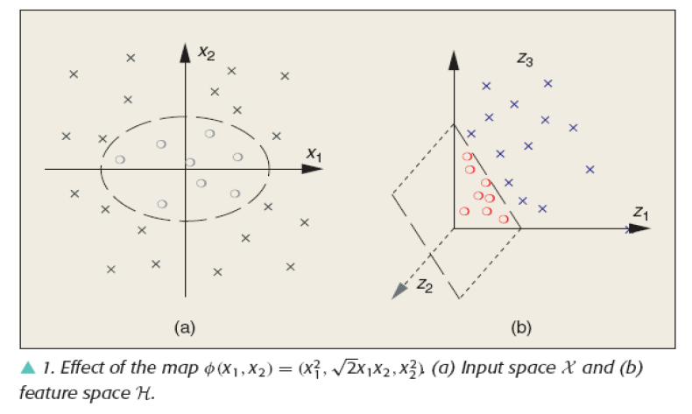
Example

Slide 5
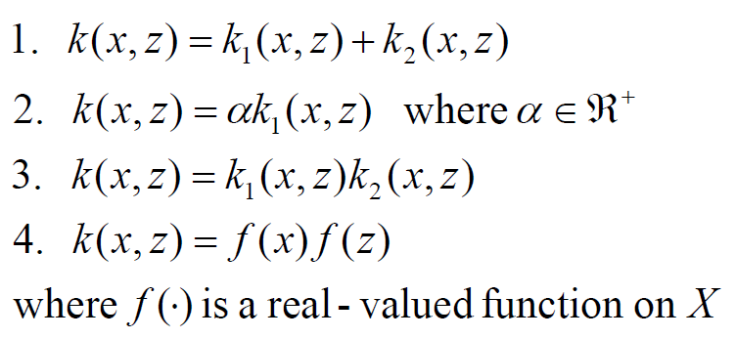
Complicated Kernels

Slide 6
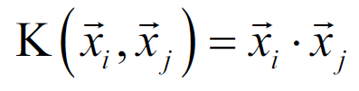
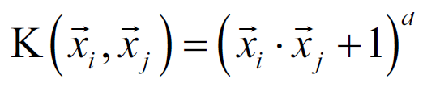

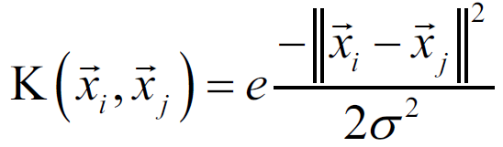
Popular Kernels
Linear kernel:
Polynomial Kernel:
Sigmoid kernel:
Gaussian RBF(Radial Basis Function) kernel:

Slide 7
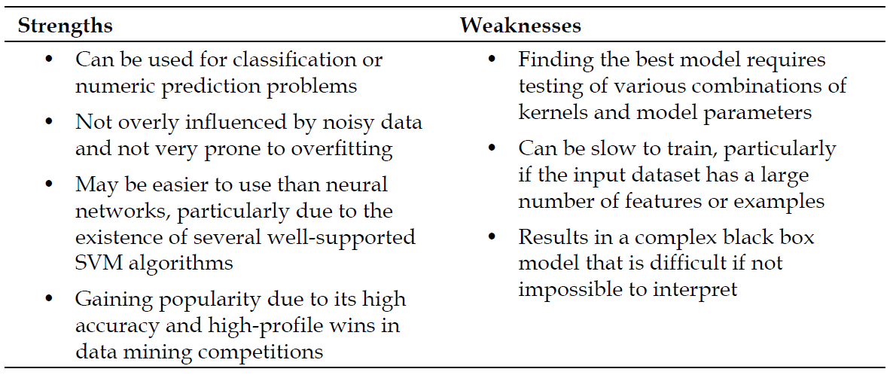
Strengths/Weaknesses

